Slide 1

Online
Quiz
[ Supervised By :- Er. Ganesh Ram Suwal]
Presented by Group :
Prajwol Ghemosu
Sagar Ghemosu
Shekhar Adhikari
Sujan Dumaru

Slide 2
Introduction
The Online Quiz is a web application for candidate to appear for an online test in an effective way and there is no loss of time to check the paper.
Online quizzes are generally free to play and for entertainment purposes only.
It can be used any time as it is a web based system.
Online Quiz features quizzes on many subjects.
Slide <number>

Slide 3
Problem Statement
Lack of space
Filtering is not easy
Filing poses a problem
Reviewing becomes time consuming
Slide 3

Slide 4
Objective
To efficiently evaluate the candidate through a fully automated system that saves a lot of time and also gives fast results.
Slide <number>

Slide 5
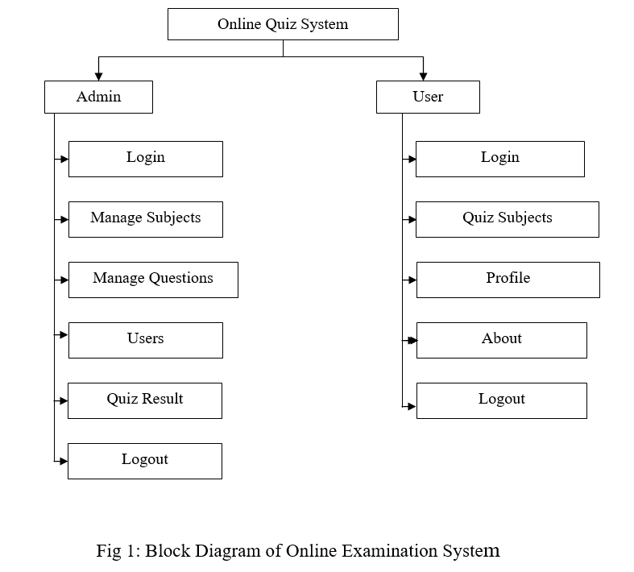
Block Diagram
Slide 5

Slide 6
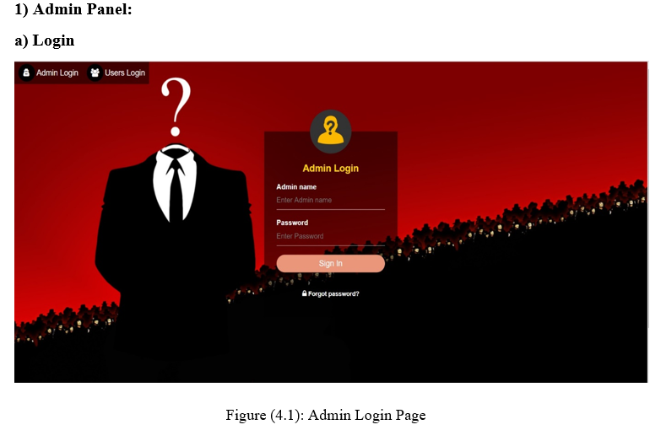
Results
Slide 6

Slide 7
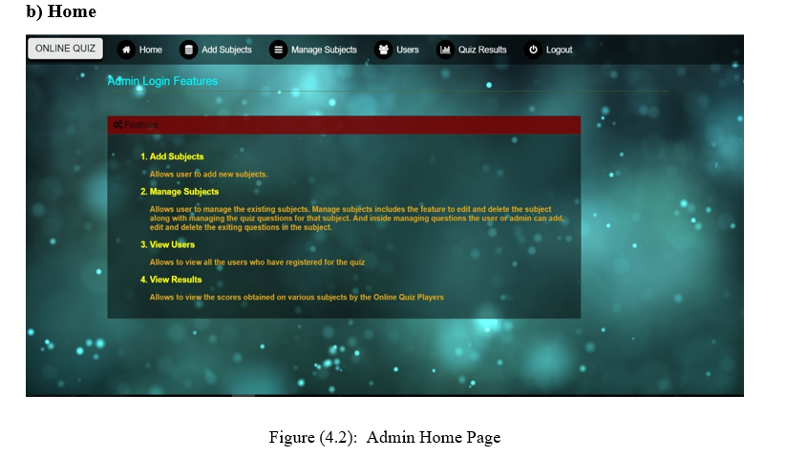

Slide 8
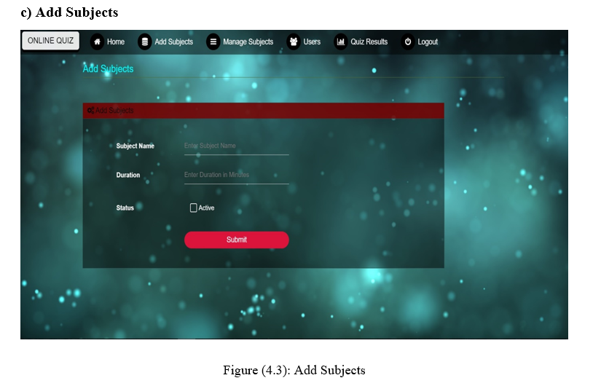

Slide 9
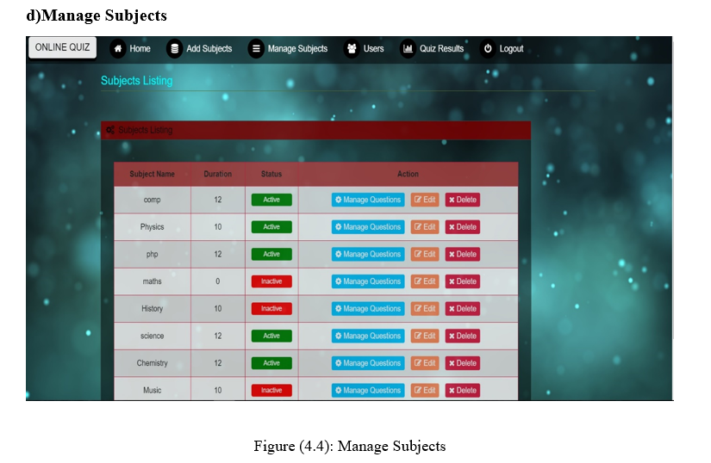

Slide 10
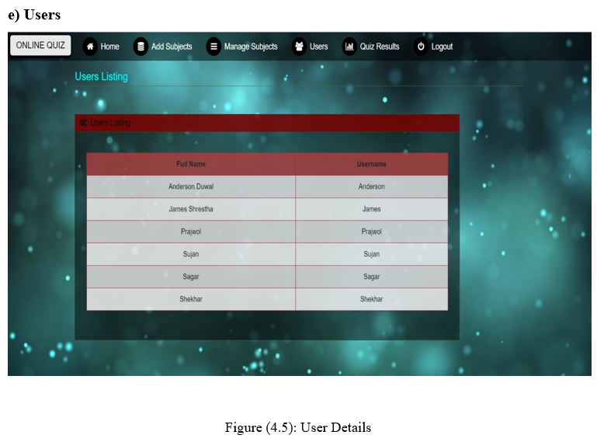

Slide 11
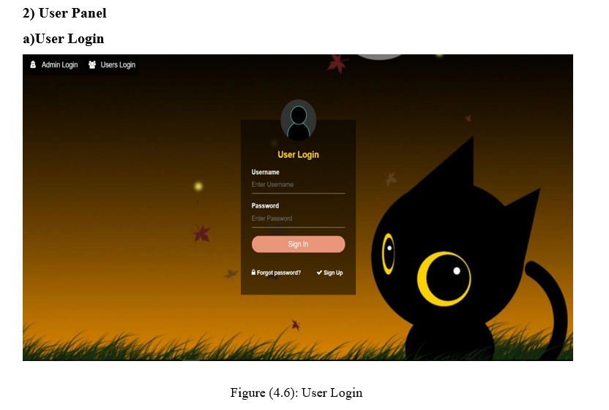

Slide 12
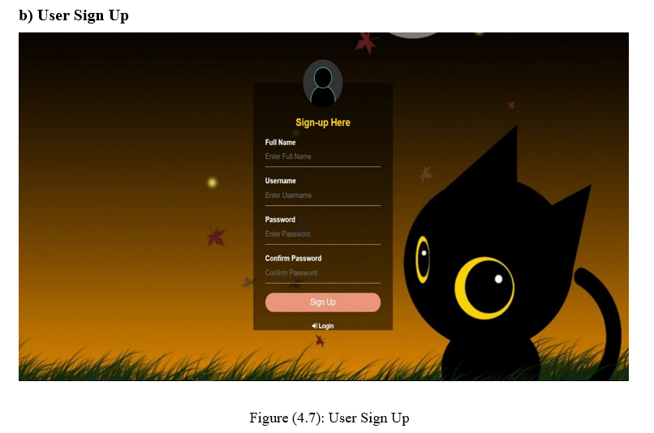

Slide 13
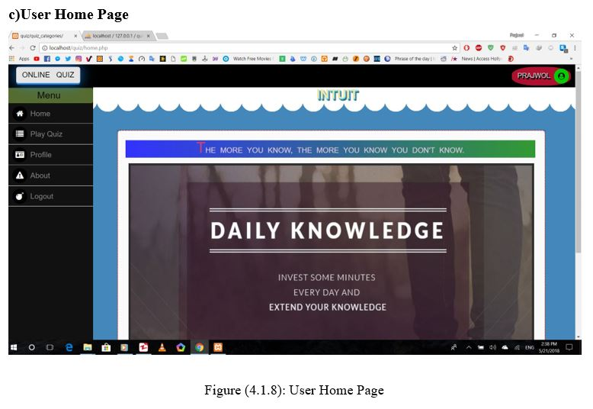

Slide 14
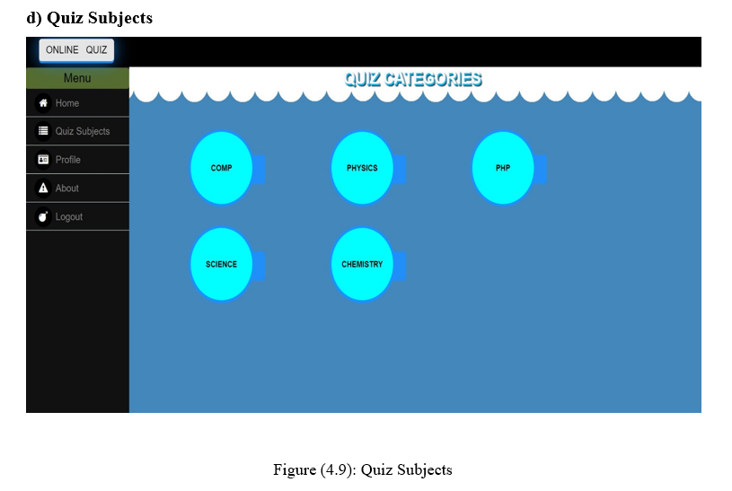

Slide 15
Conclusion
We are able to develop Online Quiz System including the function of adding questions, managing questions ,playing online quiz and viewing the score of players.

Slide 16
Future Recommendation
Make the system more responsive.
Add the timer in the system.
Increase login security to secure the information.
Make the system more user friendly.

Slide 17
THANK YOU
Slide 17

